Slide 1
PRODUCT PULSE ECOMMERCE ANALYTICS INSIGHT
Cross-Platform Performance Analysis
(Pricing & Discount)
By:
PRINCE OWUSU AGYARE (DATA / BI ANALYST)
+97433421383 | prince.agyare@gmail.com
MAY 2026

Slide 2
Executive Summary
AliExpress is the cheapest platform
Jumia operates in high-value market
Discounts do not impact ratings
Customer satisfaction similar across platforms

Slide 3
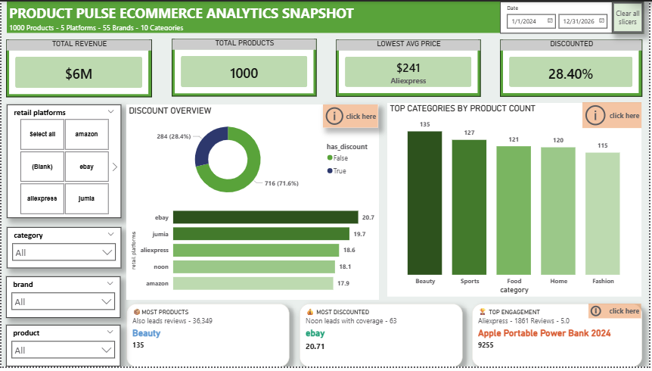
Summary Key visuals

Slide 4
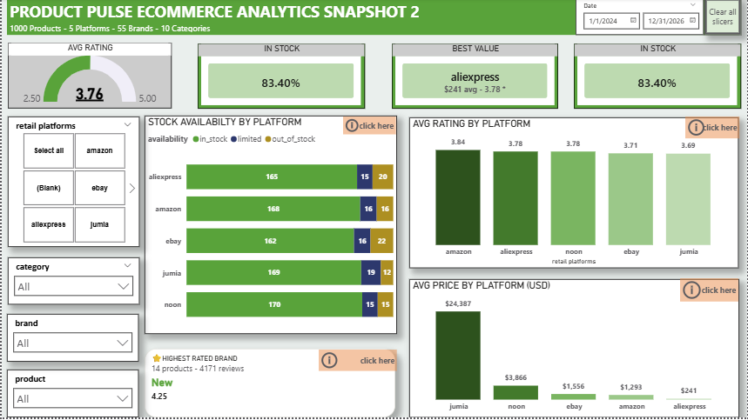
Summary key visuals cont’d

Slide 5
Pricing Analysis
AliExpress avg: $241 (cheapest) - 5× cheaper than Amazon
Cheapest for 82% of brands
Jumia avg: $24,000 (highest)
Amazon & eBay closely priced
Noon positioned mid-high

Slide 6
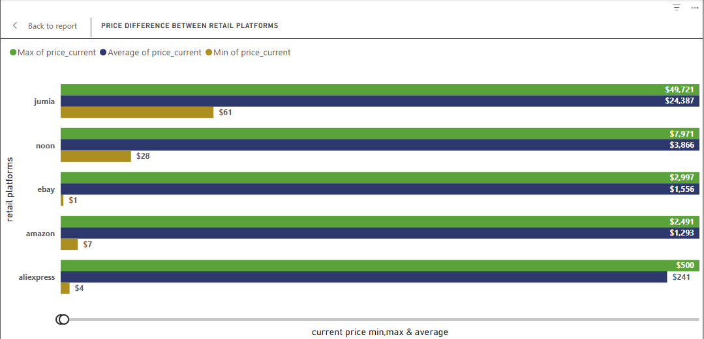
Visuals from Pricing Analysis

Slide 7
Price Extremes
Most expensive: Jumia ($47K–$49K)
Cheapest: eBay & AliExpress ($1–$3)
Large price variation across platforms

Slide 8
Discount Analysis
eBay highest avg discount (20.7%)
Only 28.4% products discounted
Discounts do not affect ratings

Slide 9
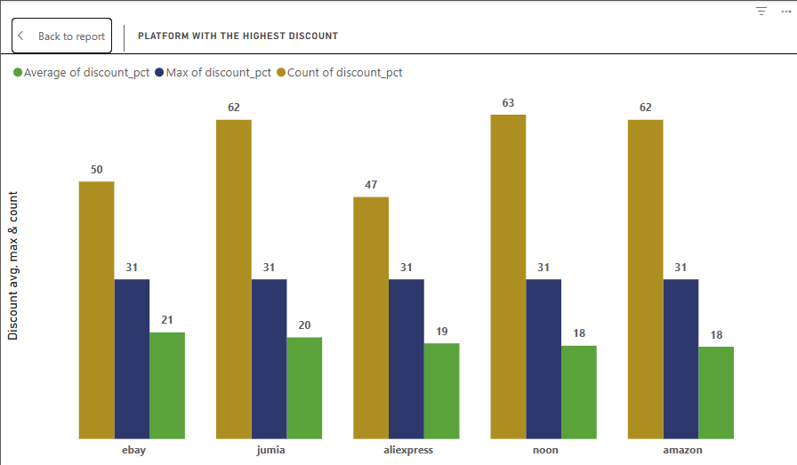
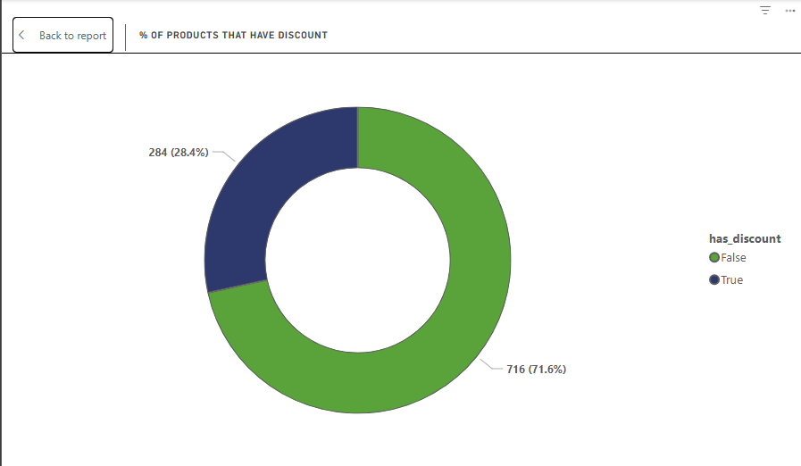
Discount charts

Slide 10
Brand Analysis
Adidas appears on 3 platforms
Nike on 2 platforms
Some brand names truncated (data issue)
AliExpress cheapest for most brands

Slide 11
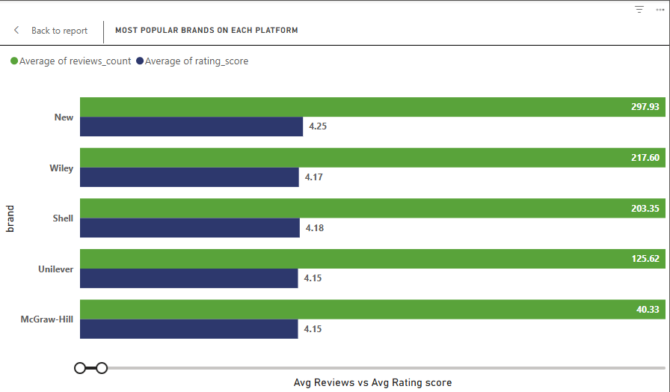
Brand charts

Slide 12
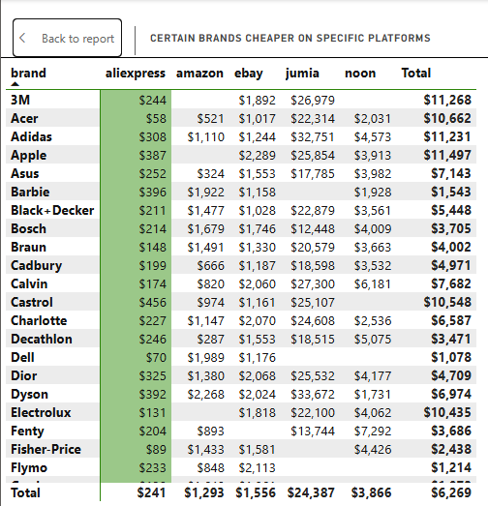
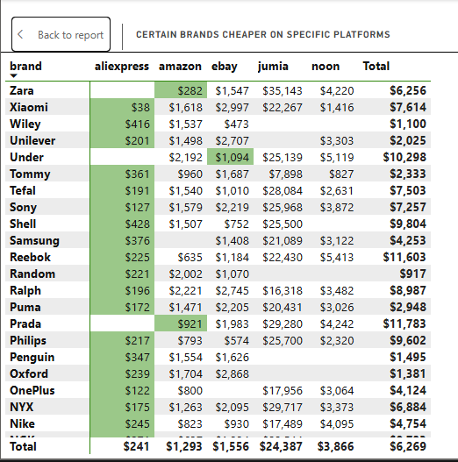
Brand price list comparison

Slide 13
Category Analysis
Most products: Beauty
Highest price: Automotive ($10K avg)
Cheapest: Books & Garden
Fashion drives engagement

Slide 14
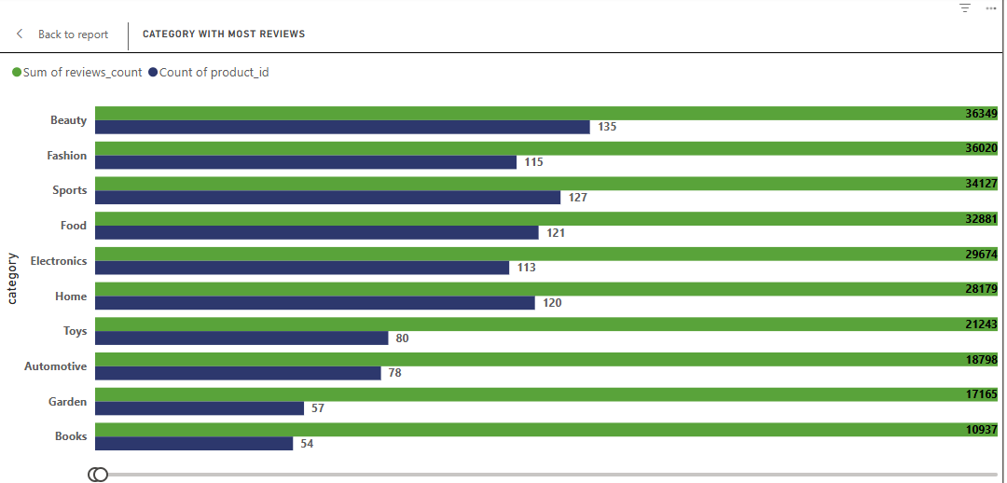
Category chart

Slide 15
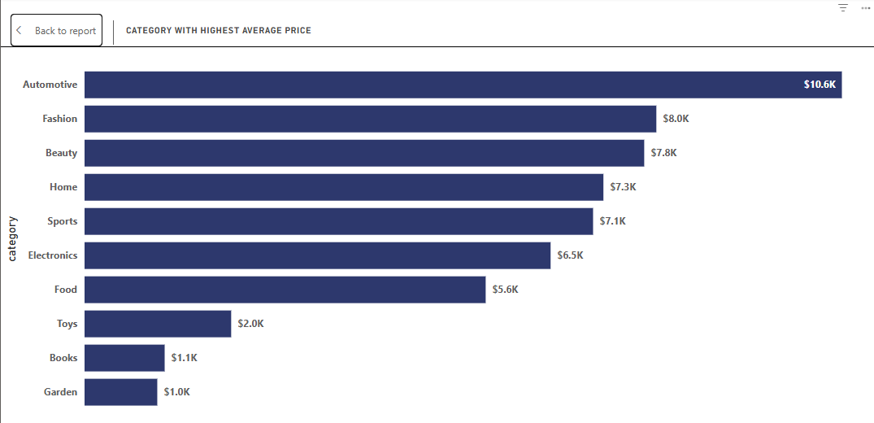
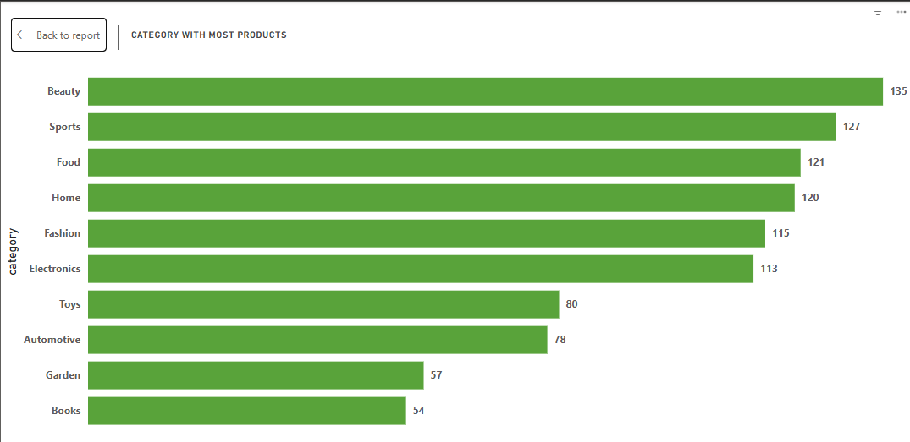
Category Rating vs Review

Slide 16
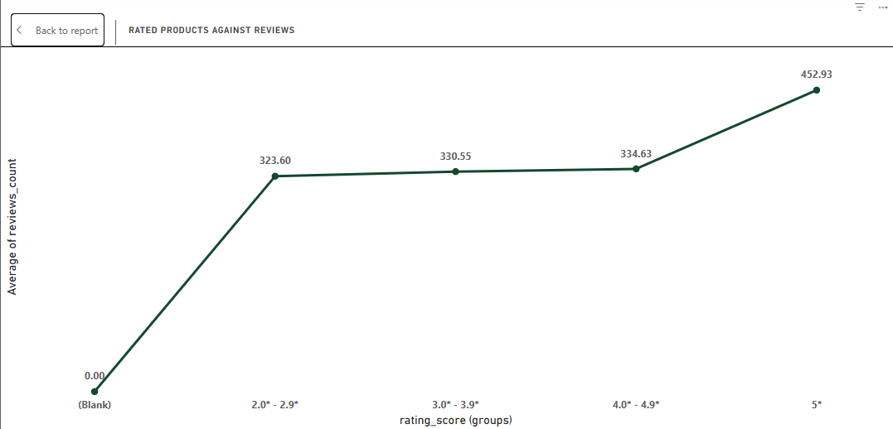
Customer Behavior
No relationship between price & rating
5-star products get more reviews
Customer perception is expectation-based

Slide 17
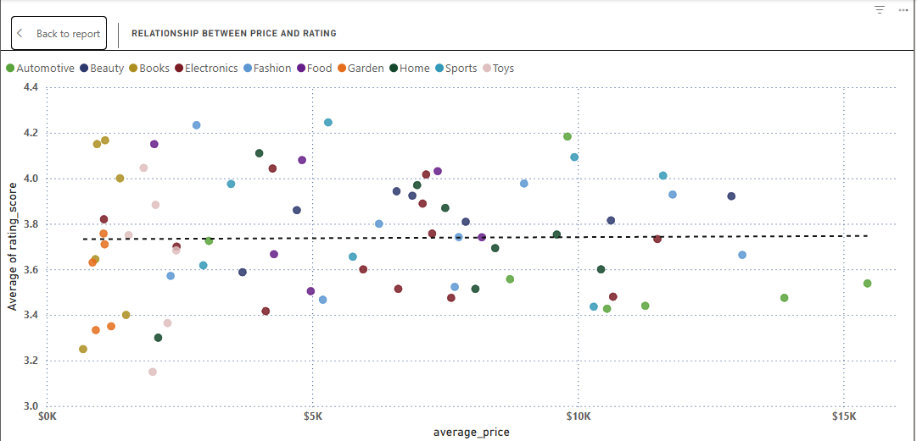
Customer behavior charts

Slide 18
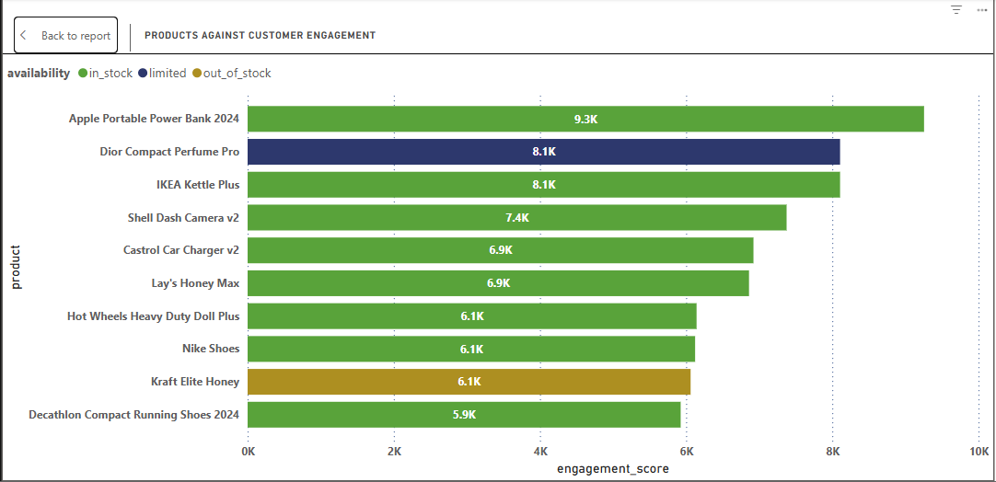
Customer engagement with products

Slide 19
Platform Comparison
Amazon highest rating (3.84★)
AliExpress best value
Noon highest availability
Small differences in ratings

Slide 20
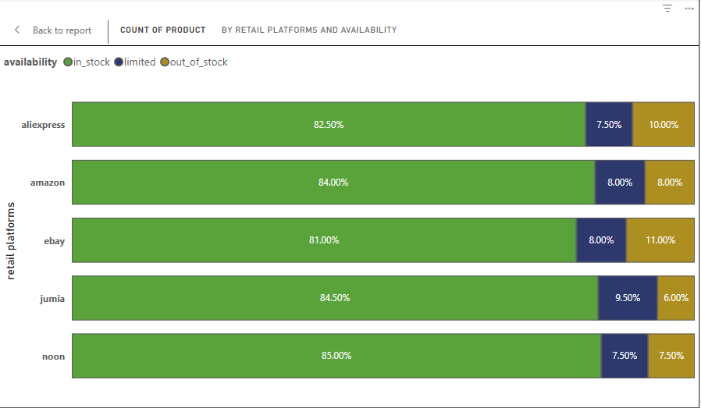
Platform Comparison Chart per stock availability

Slide 21
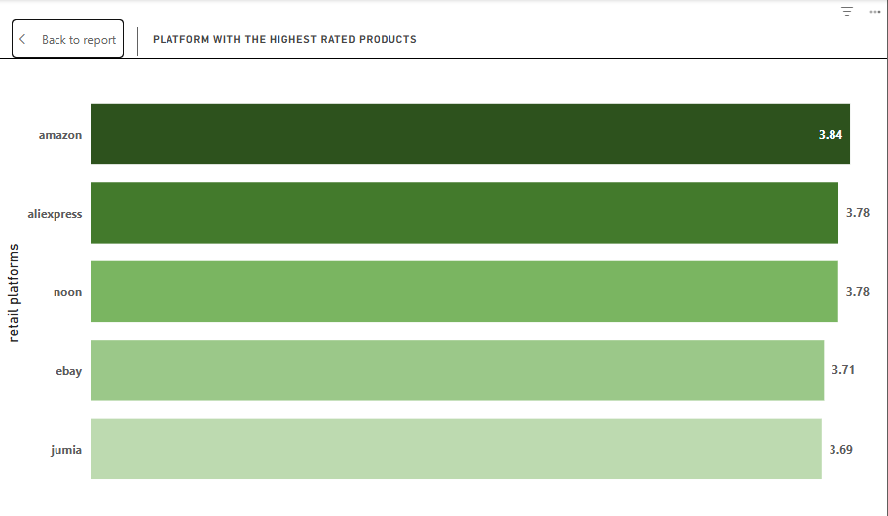
Platform comparison by rating score

Slide 22
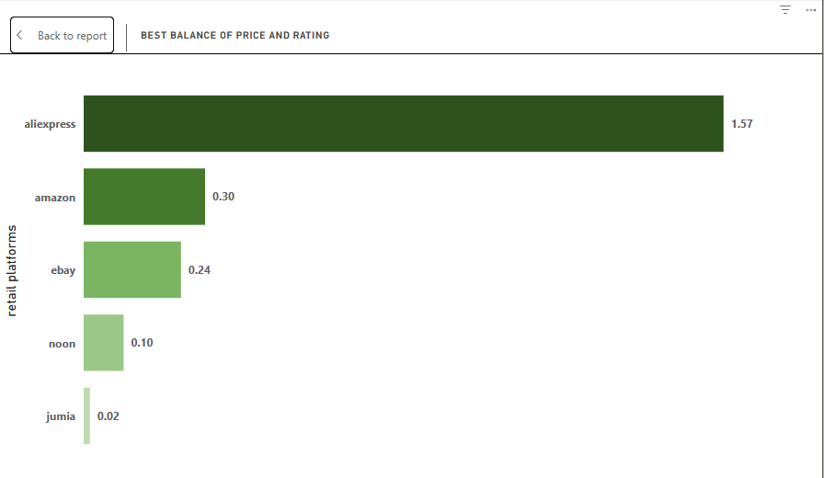
Balance between rate & price

Slide 23
Availability Analysis
83.4% products in stock
Noon: 85% | eBay: 81%
8% limited
8.5% out of stock
eBay lowest availability

Slide 24
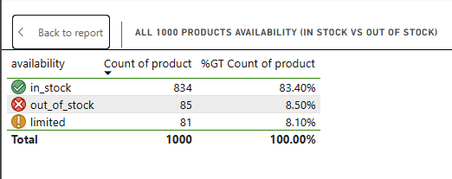
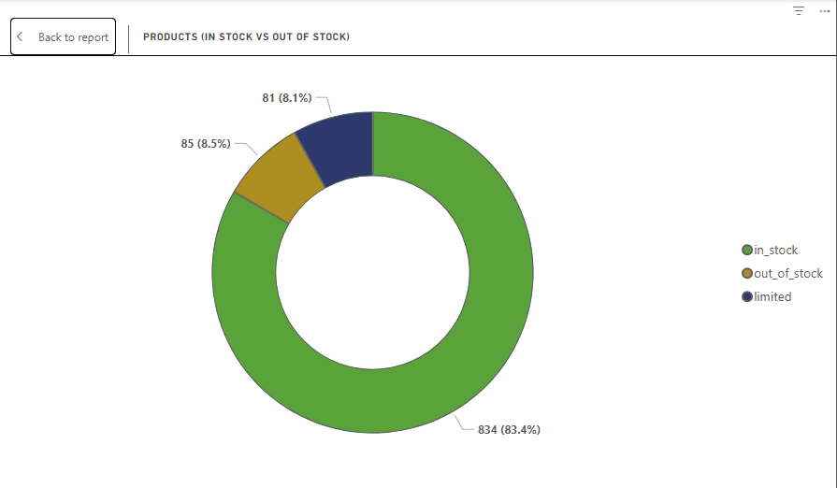
Availability chart by stocks

Slide 25
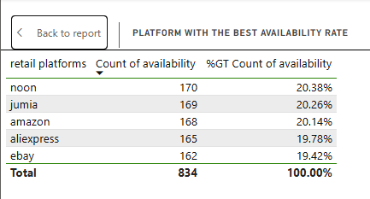
Availability rate ranking

Slide 26
Market & Currency Insight
USD dominates (60%)
Each platform uses one currency
Standardization opportunity

Slide 27
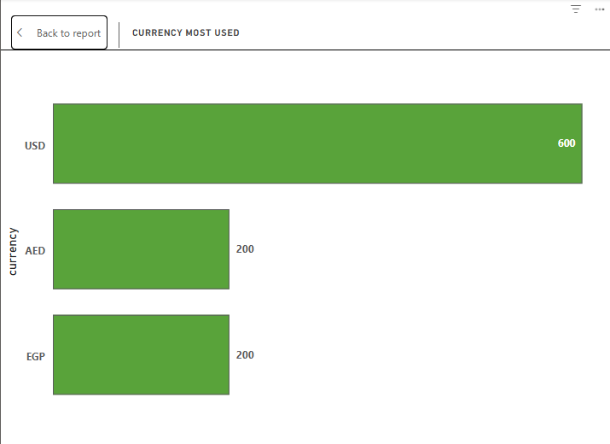
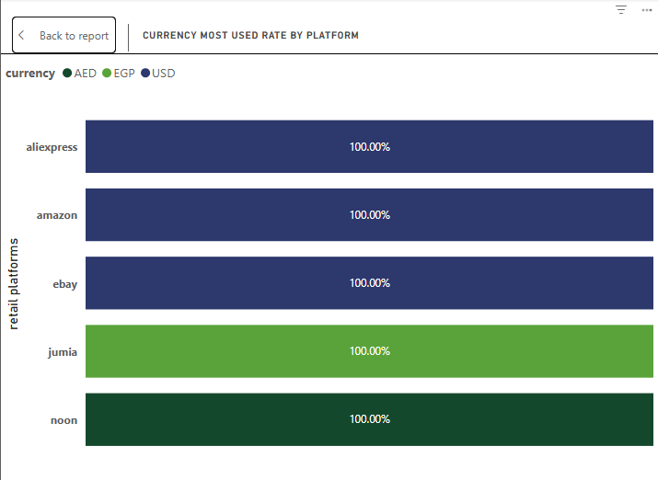
Currency usage insights

Slide 28
Key Business Insights
Pricing strategies differ significantly
Discounting not key driver
AliExpress = value leader
Jumia = premium segment

Slide 29
Recommendations
Improve data quality
Align pricing strategies
Focus on product value
Leverage high-engagement products

Slide 30
Thank You
Questions & Discussion

